Slide 1
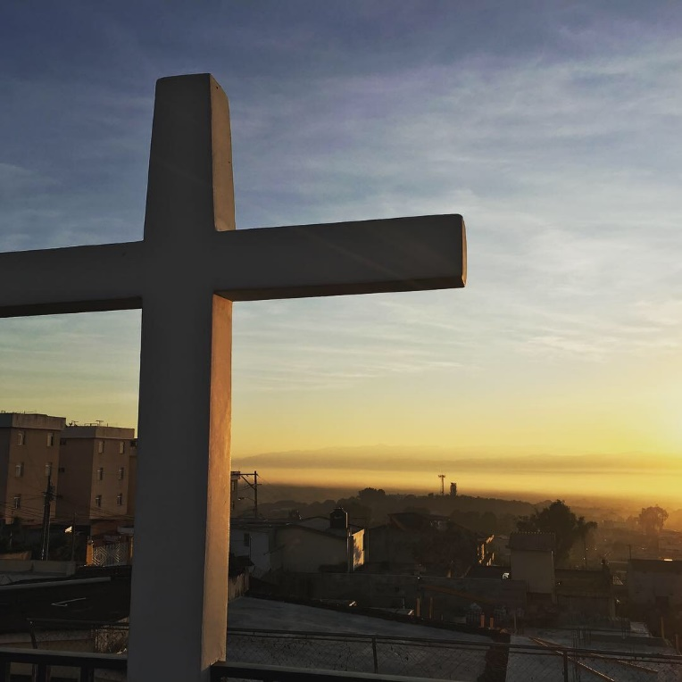
Guatemala Family Trip
December 27th -January 2nd
“The best way to find yourself is to lose yourself in the service of others”
- Mahatma Gandhi

Slide 2
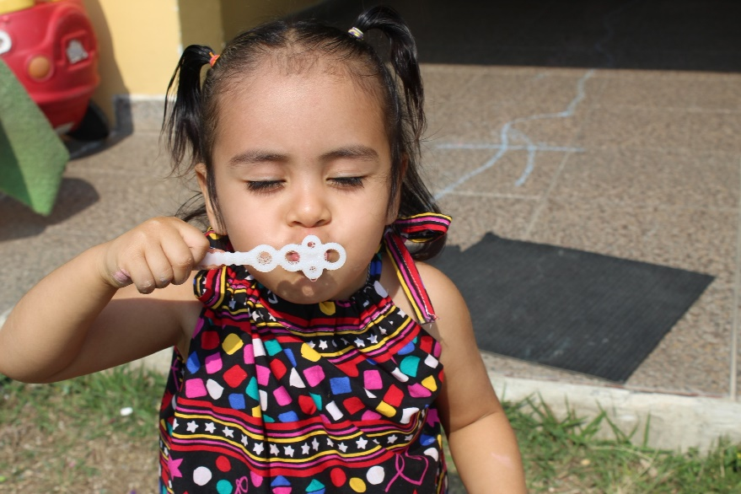
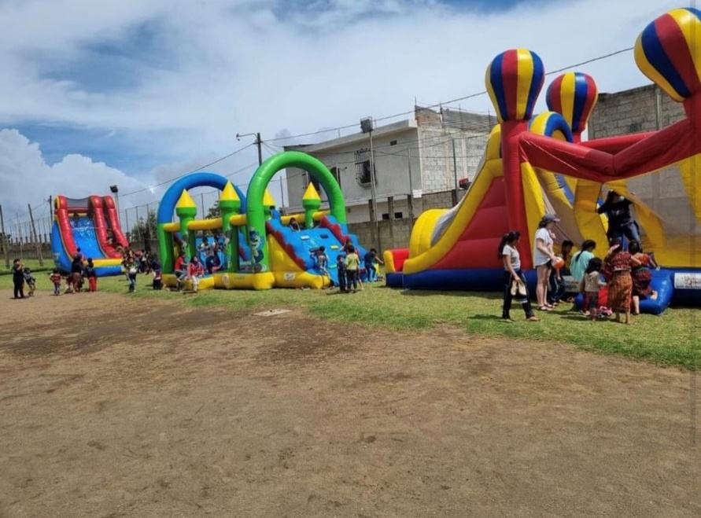
Call to Serve
A short-term trip allows us to get away from:
The daily grind of school, work, and overscheduled commitments that weigh us down
Distractions of social media, news, weights of the world
And allows us to connect:
With God – we hear him best in the quiet spaces
With our inner-self as we are given the gift of time for reflection on our lives and own spiritual journey
With our fellow team-members -whom we seemingly have much in common
With families of a community whose cultures, customs and circumstances are very different from our own

Slide 3
Our Ministry Partner - CRI
Catalyst Resources International (CRI) is our host and mission partner in Guatemala –
Fontaine(David) and Paula Greene are joined by their family in this ministry – Guatemala is their home and they are very integrated in the local community
The scope of the work done through CRI is to build houses and churches, establish feeding programs, conduct VBS, support medical and dental clinics, and provide chicken coops for families in need. They have found that meeting these physical needs has opened doors to share the Gospel of Jesus Christ.
Go Catalystresources.net to learn more about this amazing ministry

Slide 4
Opportunities to Serve
Home Construction
Water Filter Installations
Stove Installations
Bathroom construction
Children activities in the village and orphanage
Feeding program

Slide 5
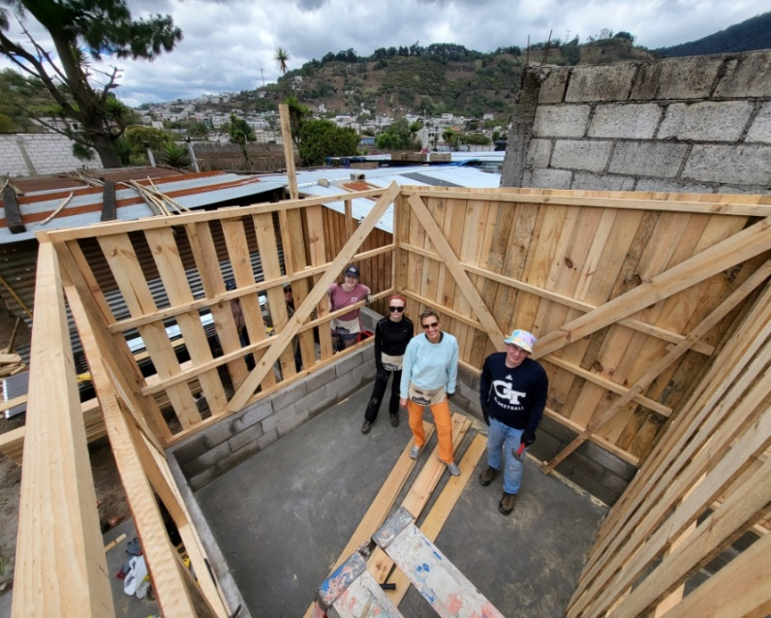
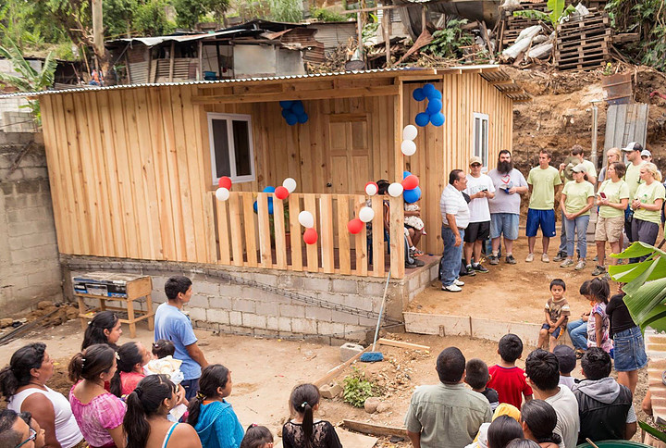
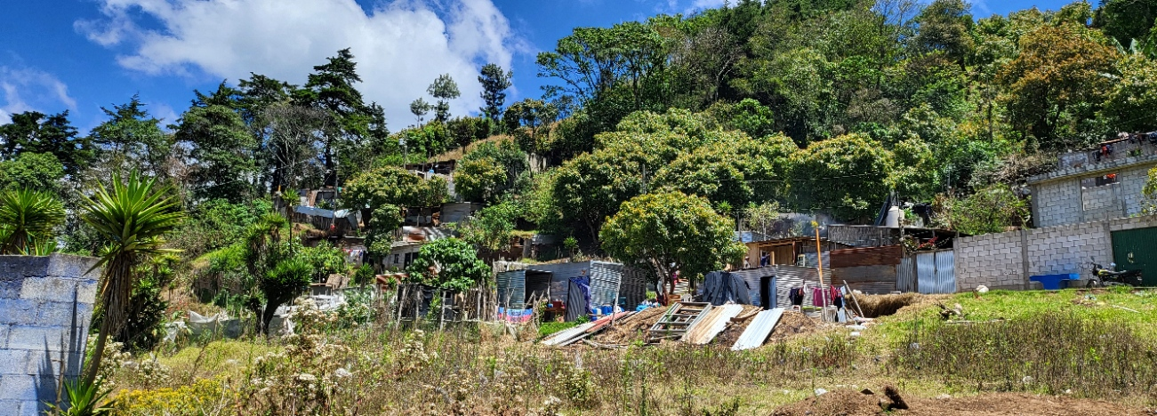
Construction Project

Slide 6
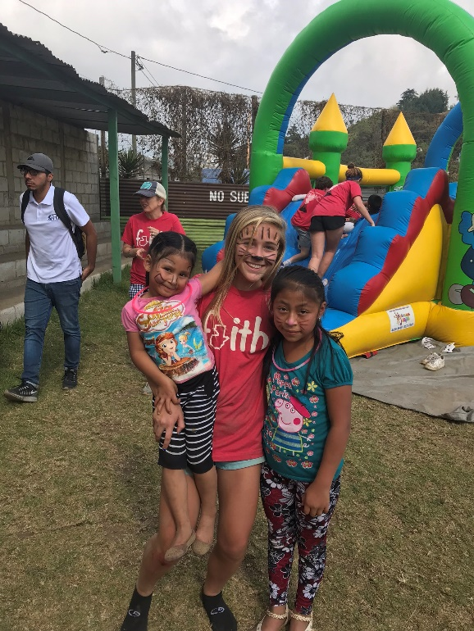
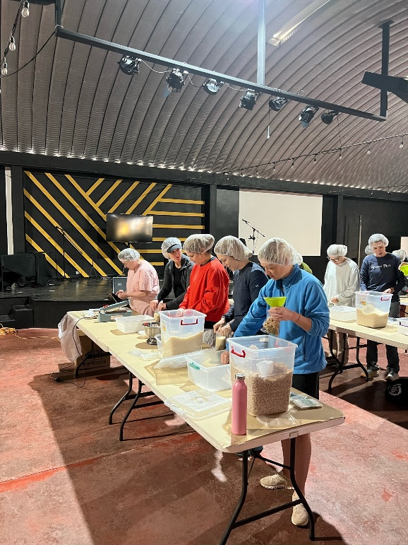
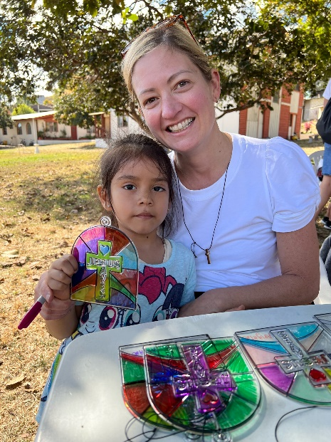
Community Festival
Feeding Program
Orphanage VBS

Slide 7
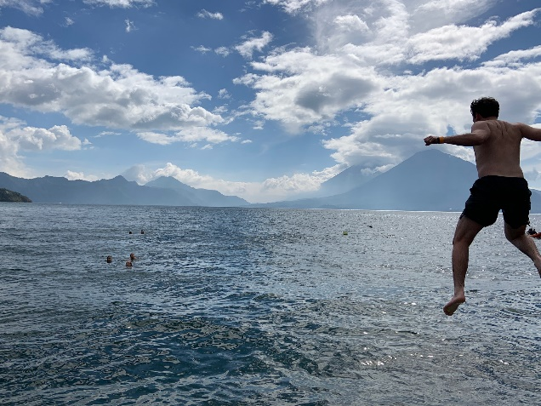
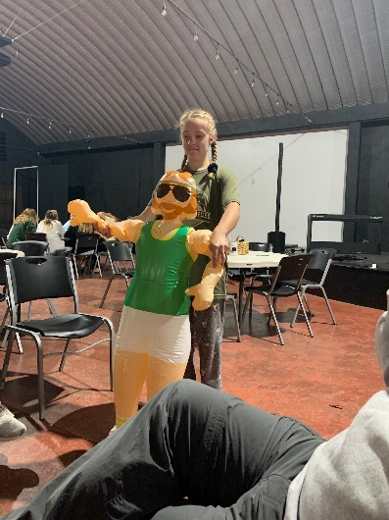
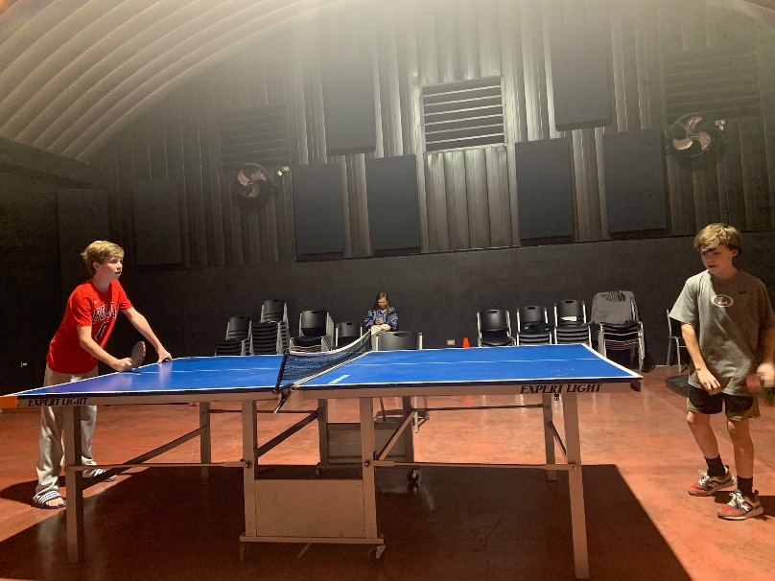
Evening Activities
And Excursions

Slide 8
Trip Details - Overview
Dates: December 27th - January 1st
Location:
Retreat Center is located in Mixco, a suburb of Guatemala City
Community ministry work takes place in Santa Maria de Jesus, located near Antigua and other rural areas in proximity
Cost: $1500 / person
Includes Airfare, transportation, room & board
Excludes excursions and personal spending money
Project Costs of approximately $25,000 are covered in full by PRUMC. This covers anything from construction, to community festival to supplies for feeding program and orphanage
Flights:
Trip originates in Atlanta and all team members are required to depart on the same flight.
Tickets will be purchased as a group through Global Missions. This allows us to travel under one itinerary which aids in logistics should flights change or get canceled. It also allows us obtain humanitarian fares which includes perks such as free excess luggage for carrying supplies.
Itinerary will include sightseeing/excursion opportunity during the trip: volcano hike, ziplines and more

Slide 9
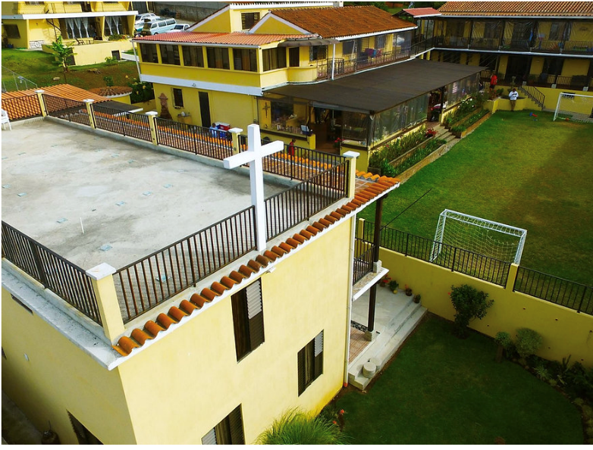
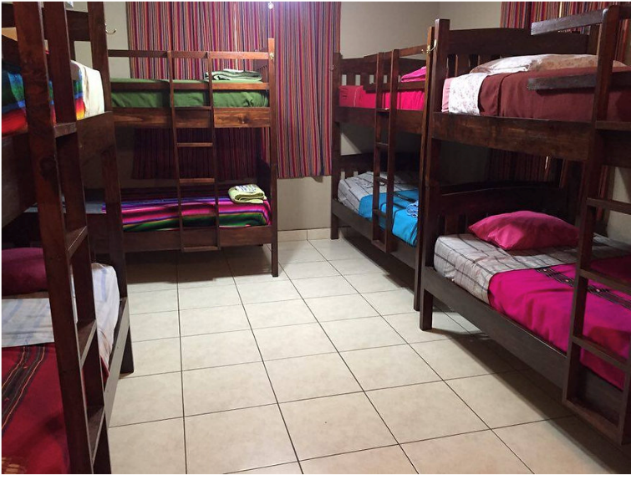
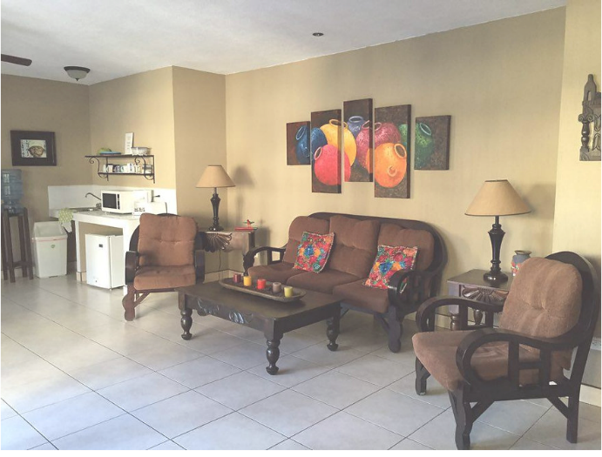
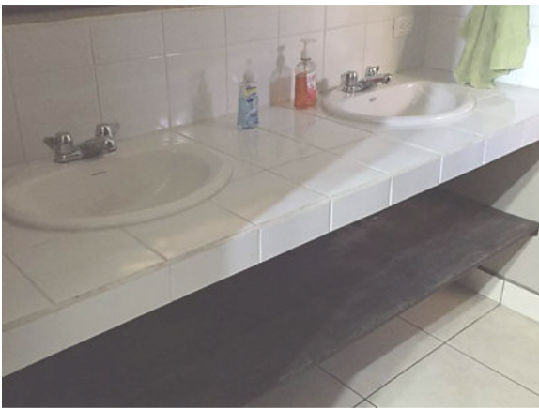
Trip Details - Accommodations
Accommodations are located at the Retreat Center, located on a secure campus.
Dormitory style housing is provided, with bunk rooms housing 8-12 guests with showers/bath within bunk room. (HOT WATER is readily available)
Common areas and green spaces within a compound create a nice retreat.]
It is a great set-up!

Slide 10
Planning
Total Cost of trip is $62,500 (based on 25 team members)
Together Global Missions and Participants are jointly responsible for fulling funding
PRUMC covers approximately $1000/person
Participants are responsible for raising or funding $1500/person
Team is required to travel on same flights. Likely will fly American Airlines, which is more price competitive to this region.
Registration takes place through online system – Service Reef
Account must be set-up for each traveler – all paperwork will be submitted online
Houses all records that are needed for filing insurance, submitting to CRI etc.
Servicereef provides an easy opportunity for us to Share our mission with friends and family, to solicit prayers and to fundraise as needed– this is a great opportunity to share what we are doing with others outside our PRUMC community and the fundraising tool makes the trip financially accessible to all
Required team meetings
Kick-off meeting at church
Teambuilding (typically offsite)
Commissioning and packing party (at church)

Slide 11
Planning
Current Requirements
No COVID specific protocols are currently in place in Guatemala
Highly recommend personal “Cancel For Any Reason” insurance as tickets will likely be non-refundable after a certain point in time.
Trip Registration is open with a $100/person deposit.
Need 4 families to register in order to move trip forward
If trip is cancelled due to lack of interest, deposit will be refunded.

Slide 12
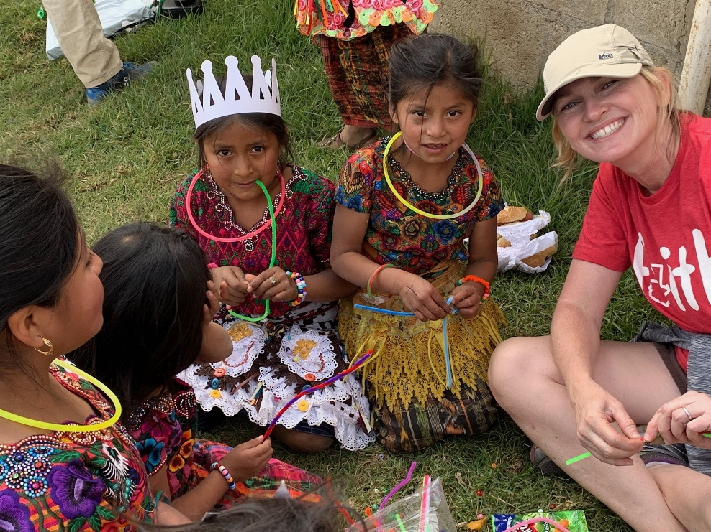
Final thoughts
Get out of your comfort zone and join a trip
Strong bonds will be formed among fellow PRUMC children/families.
We all possess gifts that we can use to serve others in Guatemala, and show God’s love for us all.
Dawnh@prumc.org

